Slide 1
INSTITUTE OF PEOPLE MANAGEMENT MALAWI (IPMM)
2017 ANNUAL CONFERENCE
SUNBIRD NKOPOLA LODGE
26th – 28th OCTOBER, 2017.
THEME:
ENERGISING BUSINESS LEADERSHIP, A FOCUS ON HUMAN CAPITAL MANAGEMENT

Slide 2
Prelude
“Somebody Has to Do Something, and It’s Just Incredibly Pathetic That It Has to Be Us.” – Jerry Garcia, the Grateful Dead

Slide 3
BUSINESS UNUSUAL IN PUBLIC AND PRIVATE SECTOR:
Roles, Opportunities and Challenges of Human Capital Management
Presented by:
Peter Monosire Muthete
Deputy Director (Public Sector Reforms)
OPC

Slide 4
THEME: Key words……………….
Energising
Business
Leadership
Focus
Human
Capital
Management

Slide 5
Why energising Business Leadership?
Ignite the ability to act or work with strength and eagerness.
There is little utilisation of human potential.
To track changes.
To create value .
To know where to make effort that makes all the difference.

Slide 6
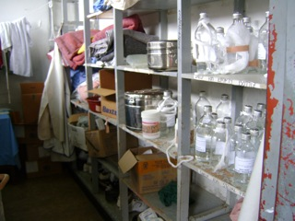
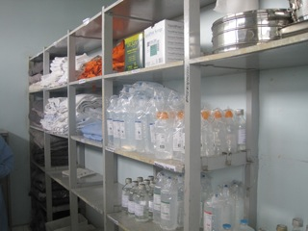
…………….improves efficiency

Slide 7

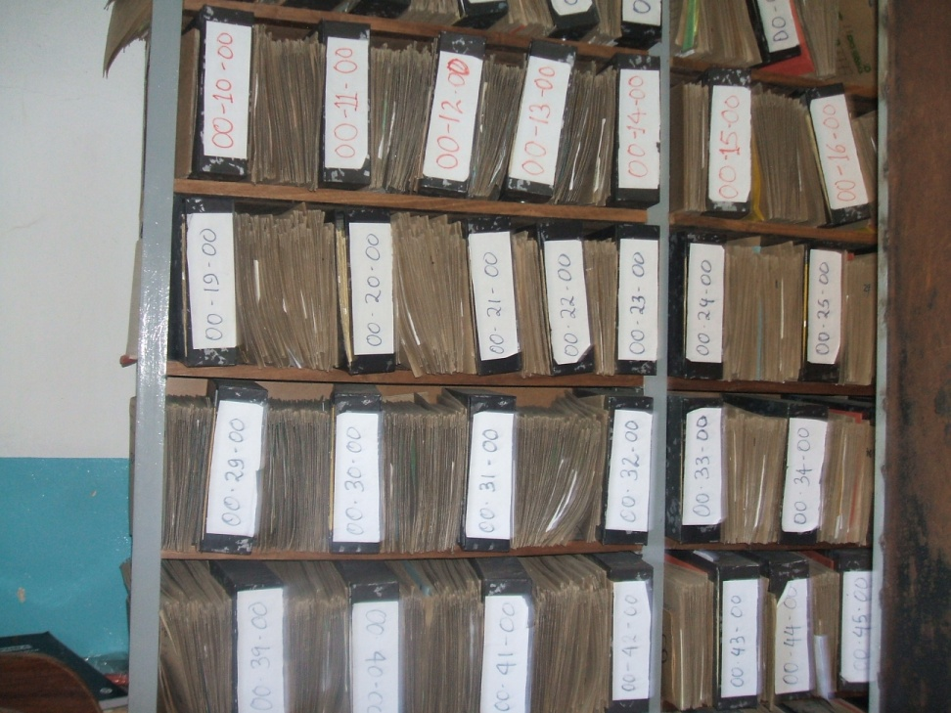
……………improves efficiency

Slide 8
Note
The challenge of Civil Service capacity building is not just replacing those who have left, but enabling able people still employed by governments to make use of their skills more productively, and also bring those skills up to date (Stevens, 2005)

Slide 9
Note
‘The manager is the dynamic, life- giving element in every business. Without his leadership, the resources of production remain resources and never become production’
(Drucker, 1955)

Slide 10
….little utilisation of human potential
“Our greatest asset is people…most managers know perfectly well that of all the resources, people are the least utilized and little of the human potential of any organisation is tapped and put to work… the manager must treat the people with whom he works as a resource to himself. He has to look to them for guidance regarding his own job”
(Peter F.Drucker)

Slide 11
……..Track changes!
‘In the old testament, God is seen as a powerful person who must be feared. However, in the New Testament God is seen as loving, caring, and most of all forgiving. It is amazing that it has taken the business world 2000 years to figure out the importance of this concept’
(Entrepreneur’s Guide book Series, 2001)

Slide 12
Cont’d
‘If no change is necessary, frankly, Management might be better’- or, at least, enough – but ‘where change is necessary Management will be found lacking, and the need for Leadership will be paramount’
(Weightman, 2004)

Slide 13
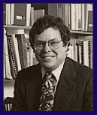
……create value
Public Value
Capacity
Support
Prof. Mark Moore

Slide 14
A FOCUS ON HUMAN CAPITAL MANAGEMENT
Why a focus on
Human Capital Management?

Slide 15
… for an organisation to survive
“Fundamentally, man is the key to all the problems, not money. Funds are valuable only when used by trained, experienced and devoted men and women. Such people, on other hand, can work miracles even with small resources and draw wealth out of a barren land’.
General Secretary to the United Nations (1953-1963), Dag Hammarskjold.

Slide 16
Lest we forget
“Organisations die because their managers focus on the economic activity of producing goods and services and they forget that their organisation’s true nature is that of a community of humans”
(Arie De Geus, The Living Company).

Slide 17
Business unusual in Public and Private Sector: Roles, Opportunities and Challenges of Human Capital Management

Slide 18
Origin of Business Unusual in the Public Sector
In 1980s
  extensive nationalization, and undue controls over the economy;
  the state and its public sector undertakings had extended beyond their capacity;
  mismanagement, nepotism, strict adherence to bureaucracy, and widespread corruption;
  developing countries realized that increasing poverty and a depressing state of affair was largely due to poor public policies and poor service delivery;
  there was a shifted from state and public sector to private sector.

Slide 19
Cont’d
Emergence of New Public Management (NPM)
  seeks to place a new approach in the traditional public administration to enhance efficiency, productivity, improved service delivery and accountability (Hughes,2003)
  Managing infrastructure like business, and not like a bureaucracy (Wold Bank, 1994)
  Sway back the role of the state by applying private sector management principles to government organisations (UNDP 2003)

Slide 20
Features of NPM
  NPM advocates:
  the reduction of rigidity, red tape, strict observance of rules, (de-bureaucratization)
  competition and reliance on market forces,
  public private partnership,
  greater reliance on private sector,
  contracting out and outsourcing.
  decentralization, public participation, citizen empowerment, greater emphasis on productivity enhancing measures,
  Innovation.

Slide 21
The New Public Service
The focus of public management should be citizen, community and civil society
The primary role of the public servants is to help citizens articulate and meet their shared interests rather than control or steer society;
Building collaborative relations with citizen and groups of citizen;
Encouraging shared responsibilities and leadership;
Seeking opportunities to involve citizens in government activities.

Slide 22
PARADIGM SHIFT
FROM BUREAUCRATIC TO ROM
BUREAUCRATIC ADMINISTRATION RESULTS-ORIENTED
Hierarchical command - Flexible/Professionally
structures oriented structures
Rules /means driven decision making - Results/Ends Driven decision
making
Appraisal based mainly on compliance - Results based performance
with rules (statutes, standing orders), appraisal
Focus on tasks/functions - Focus on client/target service beneficiaries/ CITIZEN

Slide 23
THE JOURNEY OF BUSINESS UNUSUAL IN MALAWI AND THE ROLE OF
HUMAN CAPITAL MANAGEMENT

Slide 24
Trajectory of Reforms In Malawi
The GoM has been implementing public sector reforms since independence in order to:
enhance management and institutional capacity of the Public Service to effectively deliver quality public goods and services, and
enable the country mitigate and manage emerging challenges from the fast changing global environment.
These reforms have generally been influenced by internal and global factors namely and broadly:Political, Economic, Environmental, Legal, and Technological.

Slide 25
Trajectory of Reforms In Malawi
First Generation Reforms :1964 - 1980
Second Generation : 1980- 1990
Third generation: 1990s to date

Slide 26
“ Economic and social development the world over is driven by the advancement of knowledge. Higher education institutions are key players in the production and advancement of knowledge. As such, higher education institutions are fundamental not only to the development of human capital, but also, the production of knowledge and thus the construction of a knowledge economy and society, which ultimately results in economic and social development”
(Prewitt, 2004).

Slide 27
Process versus People
Major concern, prior to Malawi’s independence- how to manage the transistion from an expatriate-based civil service to one dominated by the indegenous Malawians.
There was need to the stock of educated manpower and have supportive personnel policies.
Nyasaland Institute of Public Administration was established in 1962.

Slide 28
Skinner Commission, 1964
Redesigning of pay structure to fit the socio-economic goals of independent Malawi and job reclassification for African employees.
Though the recommendations were adopted, salaries compressed accordingly, there was little effort allotted to more important task of creating incentives in the public sector to ensure provision of basic services (Durevall, 2001)

Slide 29
HERBECQ REVIEW COMMISSION, 1985
Mandated to assess:
Modification needed in staff structure, career development, grading, and personnel management,
Capacity of training institutions to provide for the needs of the public corporations and the civil service. (Msosa, 1998)

Slide 30
HERBECQ REVIEW COMMISSION, 1985
The recommendation on staff structure, career development and job grading, which was meant to improve the quality of the service, were not fully implemented.
25% of the 7,700 management positions in the public sector and parastatals were held by expatriates (Ademolekun, 1997)
2,000 management positions were to be created (World Bank)

Slide 31
Government’s commitment….
Manpower shortages were spelt out in the Malawi Training Policy of April 1989 (Malawi Government, 1989)
This lead to the establishment of Malawi Institute of Management (MIM) in 1989
To provide in-service training and management skills-oriented training for middle and upper-level managerial staff in the public, parastatal, and private sectors of the Malawi economy (Adamolekun et al, 1997)

Slide 32
Low performance of the civil service………
Public Sector Management Review (World Bank, 1993) and Civil Service Pay and Employment (World Bank, 1993) studies found out that the performance of the civil service was low due to:
Poor definition of responsibilities,
Inadequate and poorly targeted training,
Failure to undertake programme evaluation, poor financial management, and pay levels not sufficient to attract and retain professional and technical staff

Slide 33
WHY REFORMS HAVE FAILED OVER THE YEARS
Challenges
Lack of an agreed philosophy on Public Sector Reforms
Fragmented and partial implementation of Reforms
Non alignment of Government Policies
Weak communication strategies on reform among stakeholders
Weak change management capacities in institutions

Slide 34
My argument………………..
Capacity building and need to improve efficiency and effectiveness has been a long thorny journey in Malawi.
Failure to implement already formulated policies is partly due to the shortage or lack of human capital or mismanagement of human capital.
Individual training institutions (public or private) to envision their roles in complementing Government efforts.

Slide 35
TURNING POINT !
Drive
Business unusual approach.
Championed by H.E.
Correction of mistakes
Political risk
Great Visionary Leadership
Quality Service Delivery
Challenges
Victims in short term
Comprehensive HCM

Slide 36
Strong and focused leadership….
“What happened at the road traffic is an example of strong and focused leadership and how a nation we should learn to put our foot down on ideas that in the long run will benefit this country without thinking politics or the next election. Good leaders never rescind decisions or sit on the fence when there is public outrage but work to correct the situation” (Cabinet Assessment, The Sunday Times, February 28, 2016)

Slide 37
MAIN PROBLEM
(Collins in his book ‘Good to Great)
Good is the enemy of great.
‘we don’t have great schools, principally because we have good schools......Few people attain great lives, in large part because it is just so easy to settle for a good life. The vast majority of companies never become great, precisely because the vast majority become quite good- and that is the main problem’

Slide 38
We cling to status quo
I am already a qualified HR/Chief Accountant/Manager
I have worked for a long time
Career dev… (who will pay for me)
Any additional task..(what will be the allowance)
Finally……maintain the mediocre work life

Slide 39
RATIONALE FOR REFORMS
Positioning the Public Service to meet high expectation;
Change the work culture;
Enhance Ethics and Integrity;
Ensure prudent management of Public resources;
Attract and retain competent workforce

Slide 40
REFORM AGENDA
Launch of Reform Agenda
11 February, 2015
To improve efficiency and effectiveness in order to raise quality of the Public Service
Parastatal reforms approved
October, 2015
Ministries’ Key Reforms-
Implementation
11 February, 2015
District, Town, Municipal and City Councils reforms formulated
- from 21st November to 19th December, 2016

Slide 41
HUMAN CAPITAL MANAGEMENT
Human Capital-
“the sum of knowledge, skills, experience and other relevant workforce attributes that reside in an organisation’s workforce and drive productivity, performance and the achievement of strategic goals.”
Organisational level:
“the collective sum of the attributes, life experience, knowledge, inventiveness, energy and enthusiasm that its people choose to invest in their work.”
At Gvt level, HCM
“a strategic approach to people management that focuses on the issues that are critical to an organisation’s success.”
SUMMARY:
Establishing connections between people management practices and business performance in a systematic manner.

Slide 42
HCM
Must be tailored to the goals, culture and HR practices of individual organisations.
The process involves mapping HR measures (for example, training, reward, employee retention) against business metrics ie customer satisfaction and sales figures
“If you don’t learn how to implement HCM properly, you’ll be left behind. It’s a source of significant competitive advantage and when done well, it demonstrates direct business impact” (Young, 2005).

Slide 43
Demonstration of HCM. Through…………
Rewarding original ideas and possibilities of improvements proposed by employees.
Comparing own company with competition.
Adequate usage of knowledge acquired from business environment.
Immediate undertaking of corrective actions aiming at quick removal of detected inconsistencies.

Slide 44
Demonstration of HCM. Through…
Adequate coordination of team work.
Undertaking actions based on knowledge and requiring development of human resources,.
Development of organisational culture supporting creativity and knowledge sharing.
Propagating company’s mission and strategy awareness especially among new employees, as well as undertaking actions aiming at identification of employees with company’s targets.
Determining quality targets, measures and their values, monitoring realization of assumed targets, revising the quality management system.

Slide 45
Perceiving every employee as company’s potential client,.
Rich training system and possibility of following individual career paths, providing employees with the satisfying work environment, stimulating their engagement, and contributing to development and realization of personal targets,
Stimulating initiatives, innovativeness and independency of personnel.

Slide 46
Influencing employees so they are willing to broaden their knowledge, as well as to share it and use it during performance of their duties – i.e. to base communication within an organisation on mutual trust , sharing negative knowledge – resulting from own mistakes,
Limiting control systems for the benefit of self-control ones, and developing responsibility and trust instead of supervision,
Fair treatment of employees, perceiving information as a common good.

Slide 47
Existing conditions for the development of human capital- Public Sector
Unwillingness to share knowledge caused mainly by:
Inadequate organisational culture,
Lack of benefits from sharing knowledge,
Lack of mutual trust between co-workers, feeling insecure and convinced of being not good enough,
Fear of losing knowledge, limited trust, interpersonal conflicts,
Improper communication between employees,
Insufficient identification of employees with the organisation

Slide 48
Existing conditions for the development of human capital- Private sector
There are actions taken which encourage and contribute to sharing knowledge between employees, among others, due to:
Working in project teams,
Having the system of rewards and benefits as a result of knowledge sharing,
Introducing actions to strengthen the employee attachment to the organisation, participation of employees in the decision- making process,

Slide 49
Public Sector
Private Sector
Motivation systems
Employee evaluation system
Shaping organisation culture which influences creativity
Diversification of human capital development methods in respect to individual employees
Employee evaluation system
Uniform character of human capital development methods in respect to all employees
Applied methods of Human Capital Development

Slide 50
The measuring tool
How can you measure human capital?
-Most accurate way to measure the strength of a work place-

Slide 51
Do I know what is expected of me at workplace?
Do I have the material and equipment I need to do my work right?
At work do I have the opportunity to do what I do best every day?
In the last seven days have I received recognition or praise for doing good work?
Does my supervisor seem to care about me as a person?
At work do my opinions seem to count?
Does the mission /purpose of my company make me feel my job is important?
In the last six months has my supervisor talked to me about my progress?
Last year, have I had opportunities at work to learn and grow?

Slide 52
Role (s) of HCM
The reform of structures, systems and processes
Bring changes in order to increase efficiency, cost-effectiveness and performance of organisations.
Increased pressure for the organisation to emulate private sector managerial practices, including PM, customer orientation, and a heightened strategic focus.
Improved HCM will facilitate the recruitment and retention of valued staff;
Enhance organisational cost effectiveness; and
Serve to promulgate a performance-driven culture through the adoption of a more strategic HR role.

Slide 53
Role (s) of HCM
Maximizing employee productivity to offset increased pressure on margins, there is only one choice—maximize your employees’ productivity so workforce costs are kept to a minimum.
  HCM reduces organisation’s administrative costs.
Addressing the impact of evolving workforce demographics on your company- companies are faced with managing a workforce with much different expectations and goals.
  HCM provides the tools companies need to increase their ability to recruit and train new employees, and build a pipeline of new skills for the future.

Slide 54
Role (s) of HCM
Institutionalise a culture that balances a performance driven and values-led culture.
Bring people-
Who exemplify the cultural behaviour that you are looking for.
With high values.
Who don’t expect a bonus for doing the right thing.
Who think about customer/people.
The rest of the business will then start to change.

Slide 55
Lest we forget
‘ We hire for attitude, we train for skills. It is beneficial to hire someone with the right mind-set who will fit in with the culture of your company, than someone with strong skills and great experience but an inappropriate mind-set’
(Carayol, 2016)

Slide 56
Cont’d
A Culture of Discipline-
  All companies have culture
  Some companies have discipline
  Few companies have a culture of discipline
  When you have disciplined action, you do not need excessive controls

Slide 57
Note
The real source of competitive leverage: Culture and Capabilities of your organisation, driven from how you manage the people.
Top management: attract, cultivate and keep the best workforce.

Slide 58
Cont’d ….
Why people leave their jobs?
The Gullup Organization researched that the number one reason employees leave jobs is a poor relations with their immediate supervisors.
The research finding has shown that 70% of the reasons employees leave their jobs are related to factors that are controllable by the direct supervisors.

Slide 59
Opportunities for HCM
1. To develop the strategies that can build a company’s brand through its people.
Organisations differ- set of values delivered by people. There is a link between employee satisfaction and customer satisfaction.
Organisations/companies rely on adverts/stickers to build a brand
Imagine if company’s advertising budget to spend on people.
It could create a corporate culture where people understand the company’s values and begin to behave in a way that builds customer satisfaction and loyalty.

Slide 60
Opportunities for HCM
2.To help change the landscape of business organisation ie Growth of technology, workplace & team configurations.
Determine what it is that people need and strive for in order to feel connected to a larger mission and organization.
,
Help develop the strategies that will pull organizations together..
There is a focus on process, efficiency and technology. How do you factor in the human piece.
Select the right people and provide the flexible kind of environment in which they can thrive.

Slide 61
Opportunities for HCM
3. (still relevant) Develop capability to meet the challenges presented by business in the future..
Ensuring that staff have the skills, knowledge and competencies to flawlessly execute their re-defined roles..
Provide training in the technical HR disciplines.

Slide 62
Opportunities for HCM
4. Seek opportunities to influence companies at the board level
Securing a place on the board of a company may be difficult, HR professional should seek roles as board advisors.
Exposure and a way to become fully integrated into business.

Slide 63
Opportunities for HCM
5. To develop business partner skills and to change HR’s image.
To become a strategic business partners, have stronger financial skills and be able to act as process consultants, with particular expertise in leading and managing change.

Slide 64
Opportunities for HCM
6. Large young-people market
Have potential to help would be employees, make up their minds while in school or college.
Use of career talk.

Slide 65
Adopt or adapt best practices
Driven from web built by spider
Spider Web Doctrine Mentality
If an ant or fly dare to enter, spider closes its web
Jews and Indians have used this economic behaviour to become a major economic force world wide.

Slide 66
Spider Web Doctrine(Onyeani, 2006)
Whatever money they bring in, circulates within their community
They reinvest it by buying from other Indians
They can live 20 people in the same cramped quarters till they pool resources together to buy another business
The secret is cooperativeness and their living arrangements

Slide 67
Africans - according to Onyeani(2008)
Always blame others for their lack of progress
Most of them go into business to be their own boss rather than to serve customers
Many customers complain of the owner’s attitude
The individual/owner/seller behind the counter totally ignores customers
He has the boss mentality of doing business
Customers are angered, he is unable to sell the product he has procured
Finally, he closes the shop, goes out of business

Slide 68
Obstacles to any change initiatives
It is imperative to change the work culture.
60% of failure in any initiative is contributed by resistance to change (John P. Kotter in Leading change)

Slide 69
Obstacles to any change initiatives

Slide 70

CHALLENGES

Slide 71
Challenges of HCM
HCM is in the hands of the generalists, no training gap analysis is undertaken.
Key practice areas are implemented in isolation hence they are not linked ie training and development must support recruitment and selection; performance appraisal must aid compensation management and vice versa
On going public sector reforms are actually challenging the power of personnel specialists rather than strengthening it through a focus cost control that reframes the HR function as an overhead to be cut.
Changing attitude about ‘work’
Technology- training and re-training.
Talent management.

Slide 72
Cont’d ….
Continuous centralisation imperatives limits on managerial discretion and on the degree of strategic choice to HR actors.
Relying more on the personnel management approach and more of the ‘clerk of works’ and ‘contract managers’ rather than ‘architects’
No devolution of people management issues to line managers.

Slide 73
Challenges of HCM
The HCM requires the use of rational models in designing and implementing pay policies. The rational pay policies include Performance Related Pay system, merit –based pay scheme, and competence-market competitiveness model.
Competing for talents.
Workforce planning.
Compliance.

Slide 74
Challenges
Aging workforce (recruiting – getting the right people)
Multiple generation in the workforce (controlling benefits costs), managing differing expectations and needs, retooling skill sets, phased retirement).

Slide 75
Dilemmas
A problem is a challenge with a potential solution; you find and apply the solution, and the problem goes away.
A dilemma is an on-going challenge and has has no solution.
A leader must work constantly to maximise the benefits and minimise the drawbacks of both sides.

Slide 76
Dilemma: Polarity Management
Common standards, high efficiency, access to resources, credibility with external partners, esprit de corps
Positive Centralised
Responsiveness to local needs, speedy decision making, high accountability, sense of initiative.
Positive Decentralised
Lack of standardisation, inefficiency, scarce resources, low credibility with partners, disconnection.
Negative Decentralised
Unresponsiveness to local needs, slow decisions, low accountability, lack of initiative.
Negative Centralised

Slide 77
Common Dilemmas
Centralised
Cost
Long term
Individual
Adaptability
Tradition
Employee centric
Market driven
Efficiency
Planning
Profit
global
Decentralised
Quality
Short term
Team
Stability
Innovation
Customer centric
Product driven
Engagement
Action
Growth
local

Slide 78
Conclusion
Both the private enterprise and public institution believe that it is necessary to manage human capital e.g. in the scope of stimulating innovativeness or improving communication.
The surrounding world requires more and more from the private business sector and public administration.
Pieces of legislation enacted to govern HCM should focus more on creating commitment rather than maximising compliance and control of staff through rule-book and rigid personnel management procedures.
The human capital as a crucial resource of every organisation requires special attention.

Slide 79

An Elephant in the Path
Too often we understand the vision and wants to make it happen, but an elephant appears to be blocking the path!!
The elephant could be:
  In the head of the person
  Leadership/Motivation
  Policies
  Particular individuals
Confront and remove the big elephants first, and monitor progress

Slide 80
Personal……..
‘Okonkwo was well known throughout the nine villages and even beyond. His fame rested on solid personal achievements’
‘He did not inherent a barn from his father. There was no barn to inherit’
(Chinua Achebe, 2008)

Slide 81

http://edition.cnn.com/2010/OPINION/08/08/greene.obama.ambition/index.
"Dear Mr. Governor:
I hereby resign effective
November 16, 2008 from the United States Senate in order to prepare for my duties as President of the United States.
Sincerely,
Barack Obama“
“Impossible things can happen to a person. But first, a person has to try”
(Bob Greene- Editor, CNN)

Slide 82
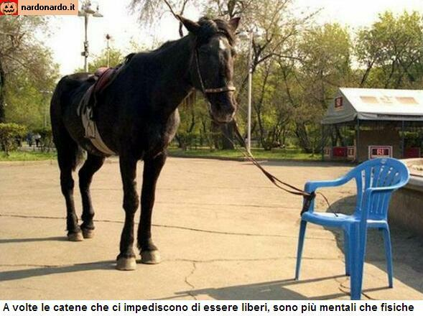
Sometimes the chains that prevent us from being free are more mental than physical
Sometimes the chains that prevent us from being free are more mental than physical

Slide 83

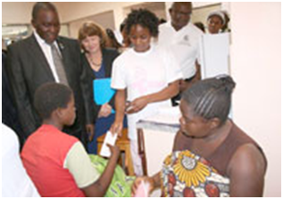
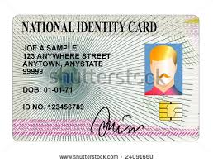
2.
Production and Issuance of the national ID
1.
Registration of births and deaths and issuance of relevant certificates.

Slide 84
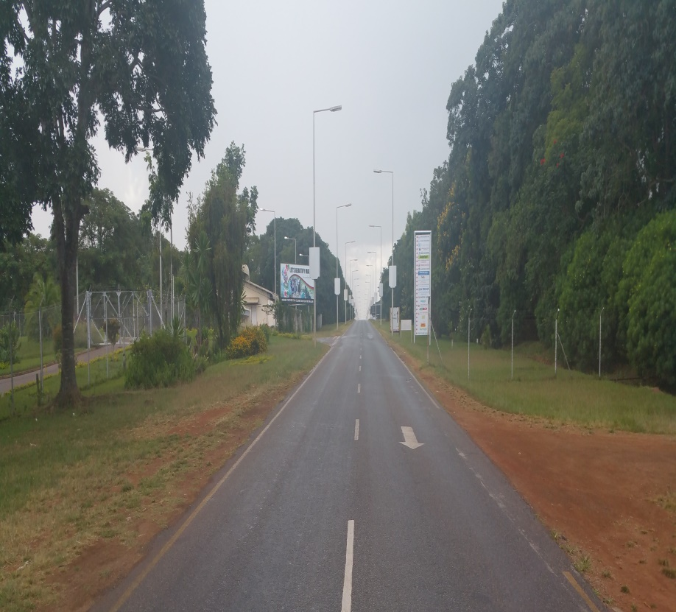
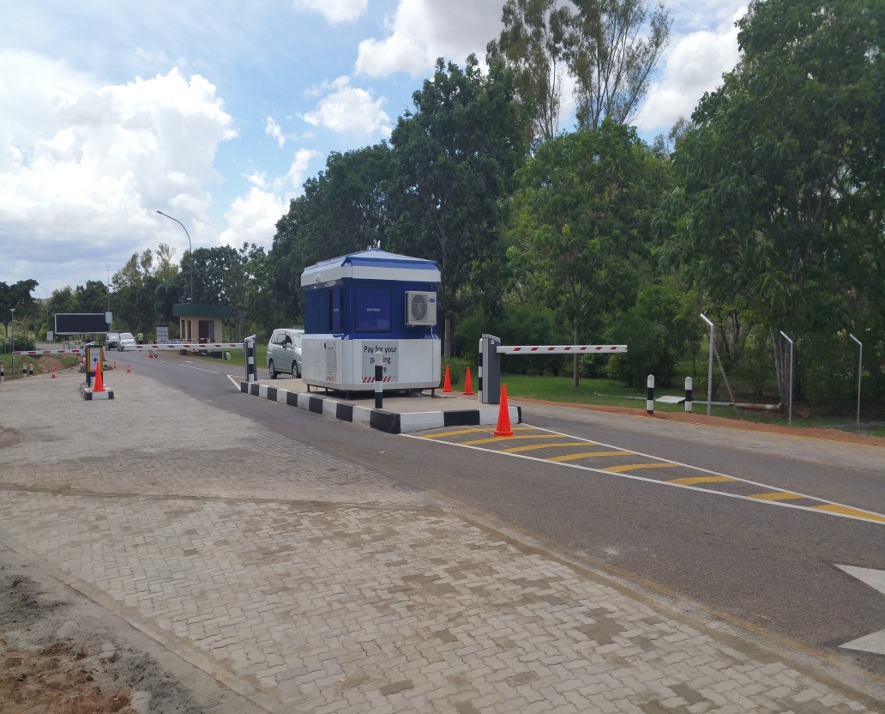
Reforms at ADL
Tollgate and car park automation at KIA has been fully implemented resulting in 150% increase in fee collection per month
Before
After

Slide 85
PICTORIAL

Slide 86
“Public officials could never entirely forsake their personal moral responsibility; even though they are bound by authority to their political masters, they remain independent, accountable, moral actors” (Moore, 2002:294)

Slide 87

THE END!
Thank you!

Slide 88
References
Bana (2008): Enhancing the performance of the Public Service in a Developmental State, Accra, Ghana.
Muthete (2010): A Preliminary Evaluation on Malawi’s Induction Program for newly recruited civil servants, Shinghua University, Beijing, PRC.
Society for Human Resource Management (2002): www.shrm.org

